Slide 1
Specific heat capacity

Slide 2
Different substances are easier or harder to heat up than others.
That is, they require a different amount of energy to increase their temperature by the same amount.
You can test this (and ruin a kettle) by observing how long it takes a kettle to heat 1L of water to 100°C and comparing it to how long it takes to heat 1L of oil to reach 100°C
The kettle transfers the same amount of energy every second in each test, but oil requires less energy to raise its temperature, so will reach 100°C quicker.

Slide 3
Specific heat capacity
Specific heat capacity is the amount of energy required to raise the temperature of 1 kg of a substance by 1 degree Kelvin (Or Celsius)
Symbol- c
Units- J kg⁻¹ K⁻¹

Slide 4
If we add energy to a substance, it’s temperature will increase, in direct proportion to the amount of energy added.
Experiments have shown if we halve the mass, but apply the same amount of energy to a substance, its temperature will rise by twice as much.

Slide 5
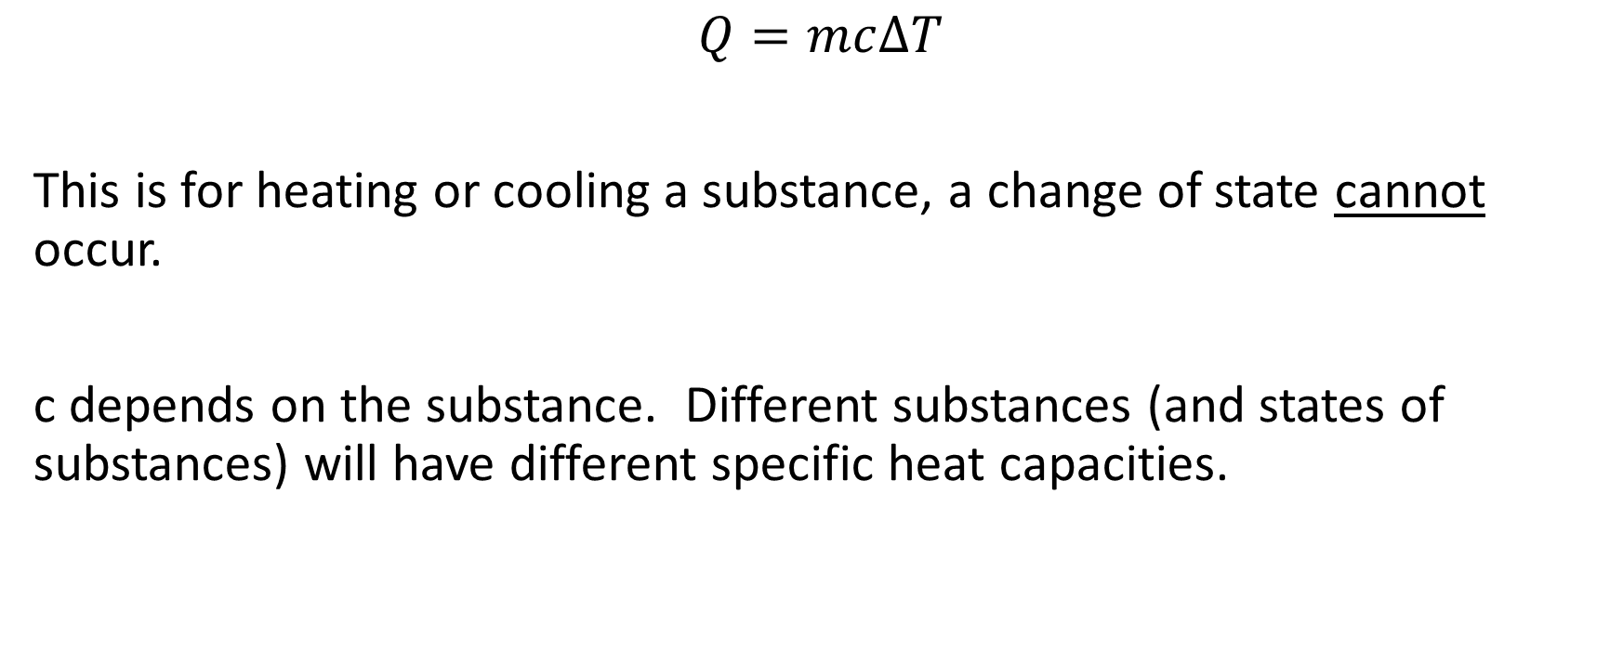
$$Q=mc∆T$$
This is for heating or cooling a substance, a change of state cannot occur.
c depends on the substance. Different substances (and states of substances) will have different specific heat capacities.

